Slide 1
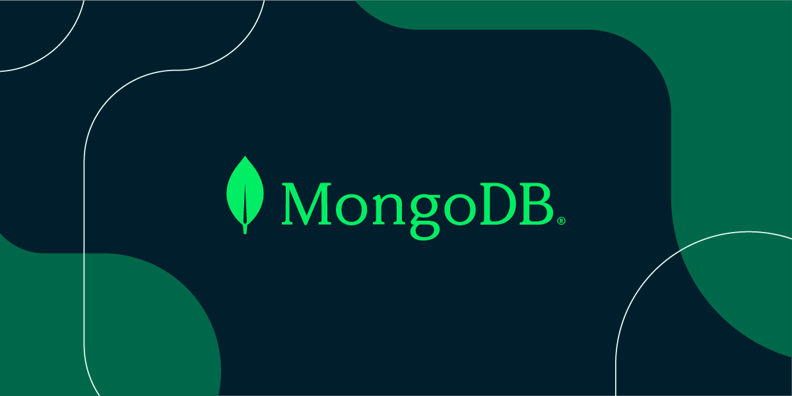
INSTALLATION

Slide 2
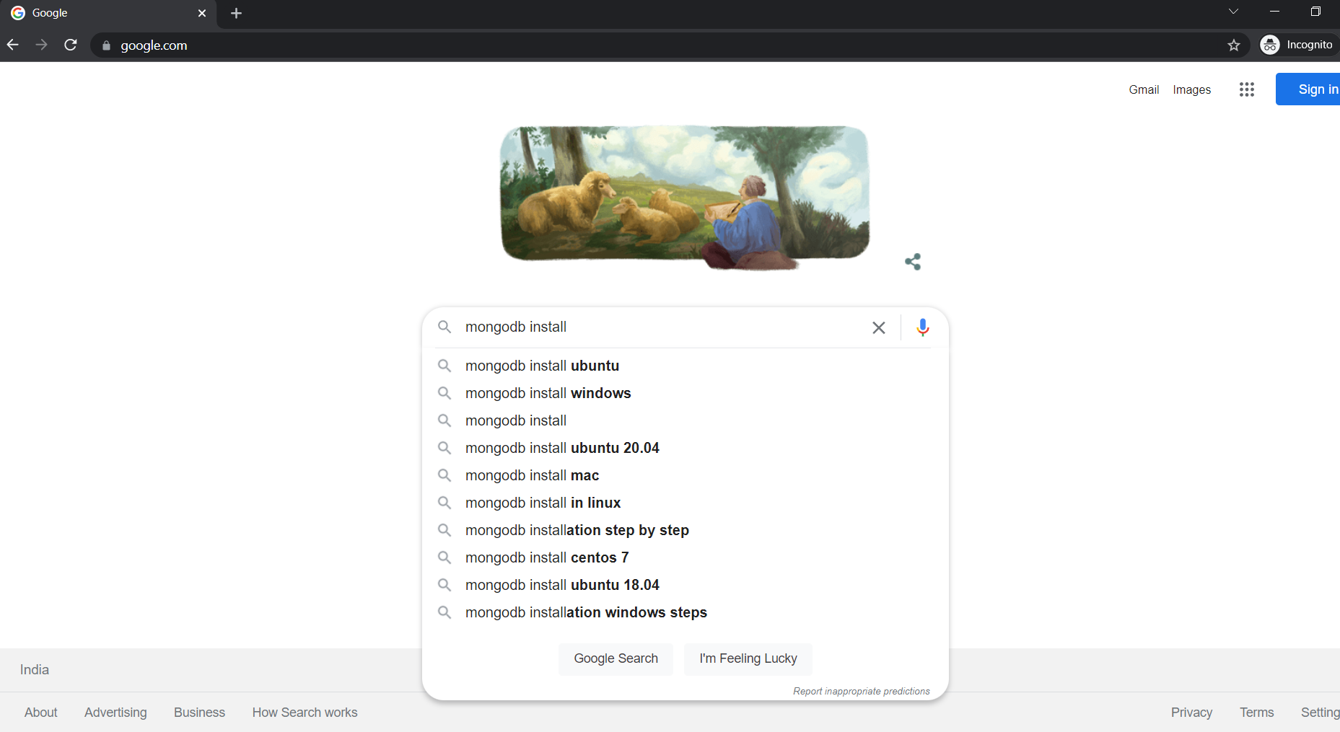
Search

Slide 3
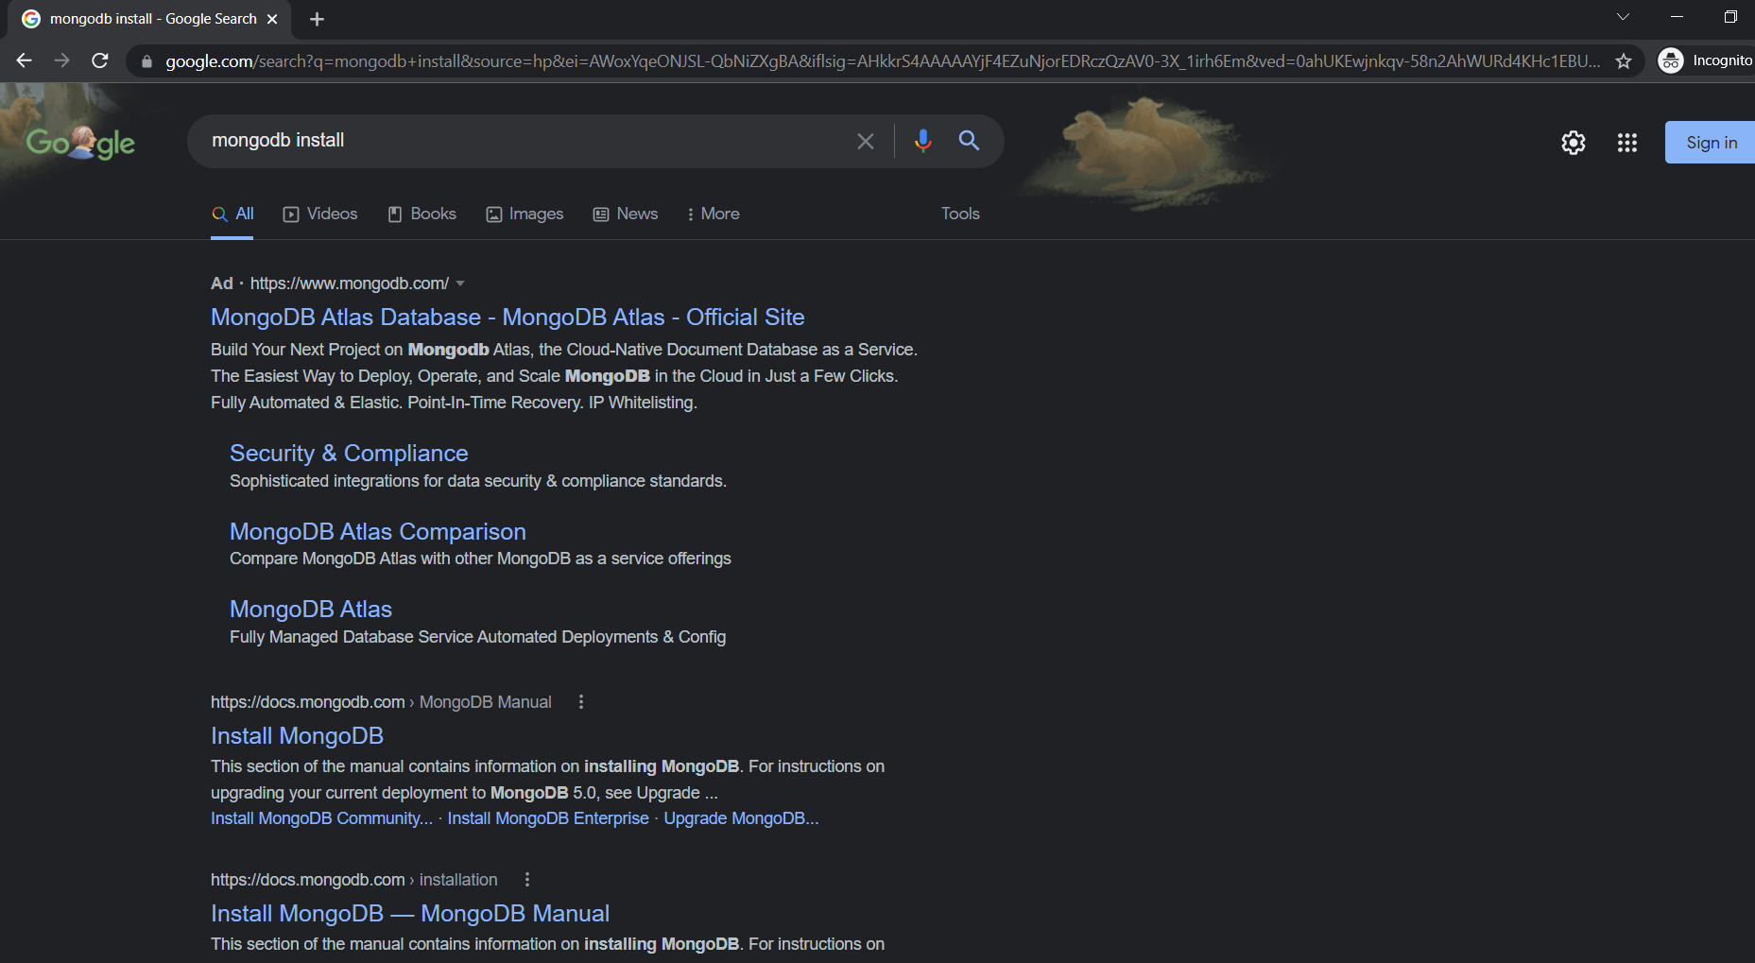
Click

Slide 4
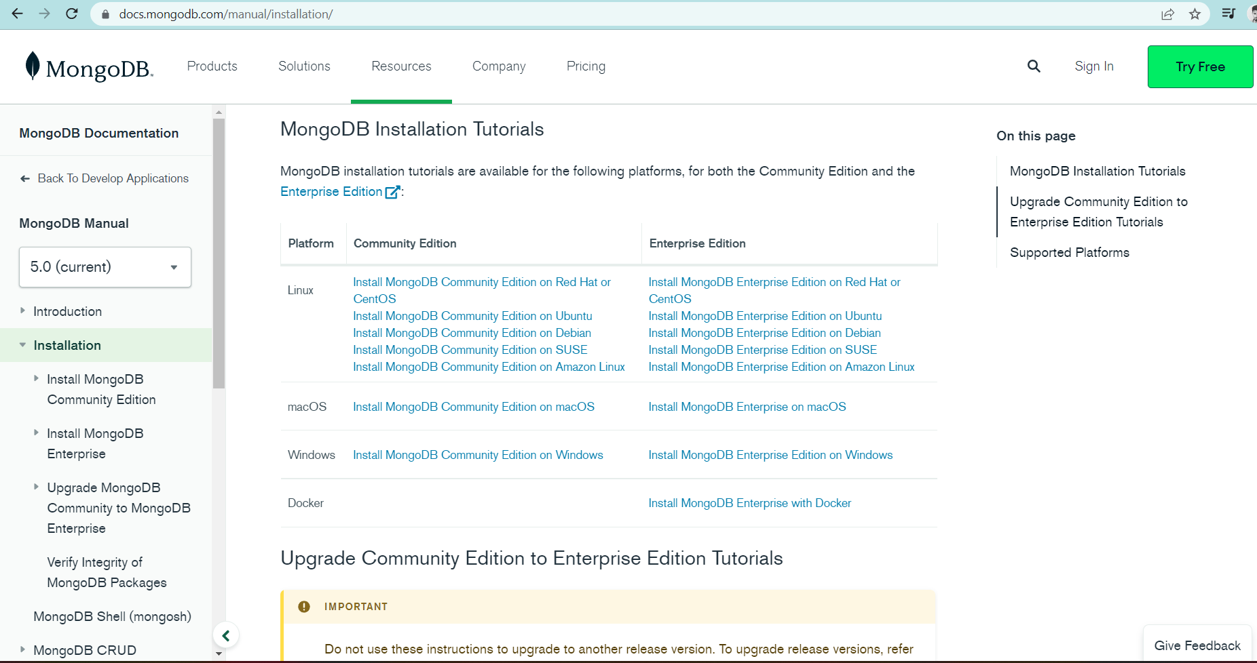
Click the community edition only,based on your PC needs

Slide 5
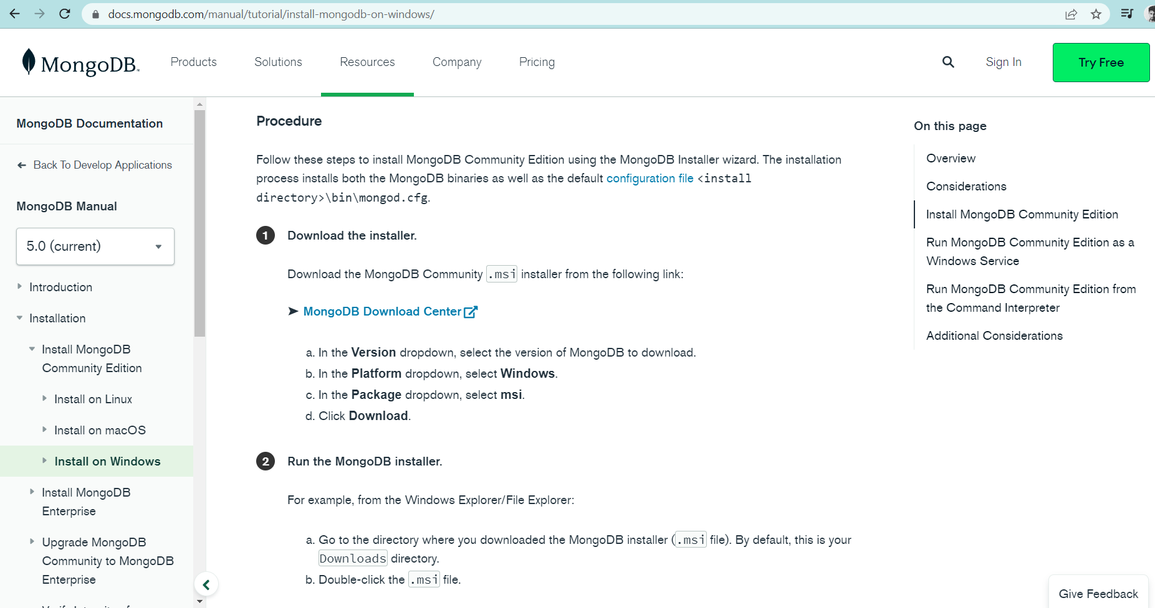
Next step: You will lead to new page and scroll down you will be able to MongoDB Download Center

Slide 6
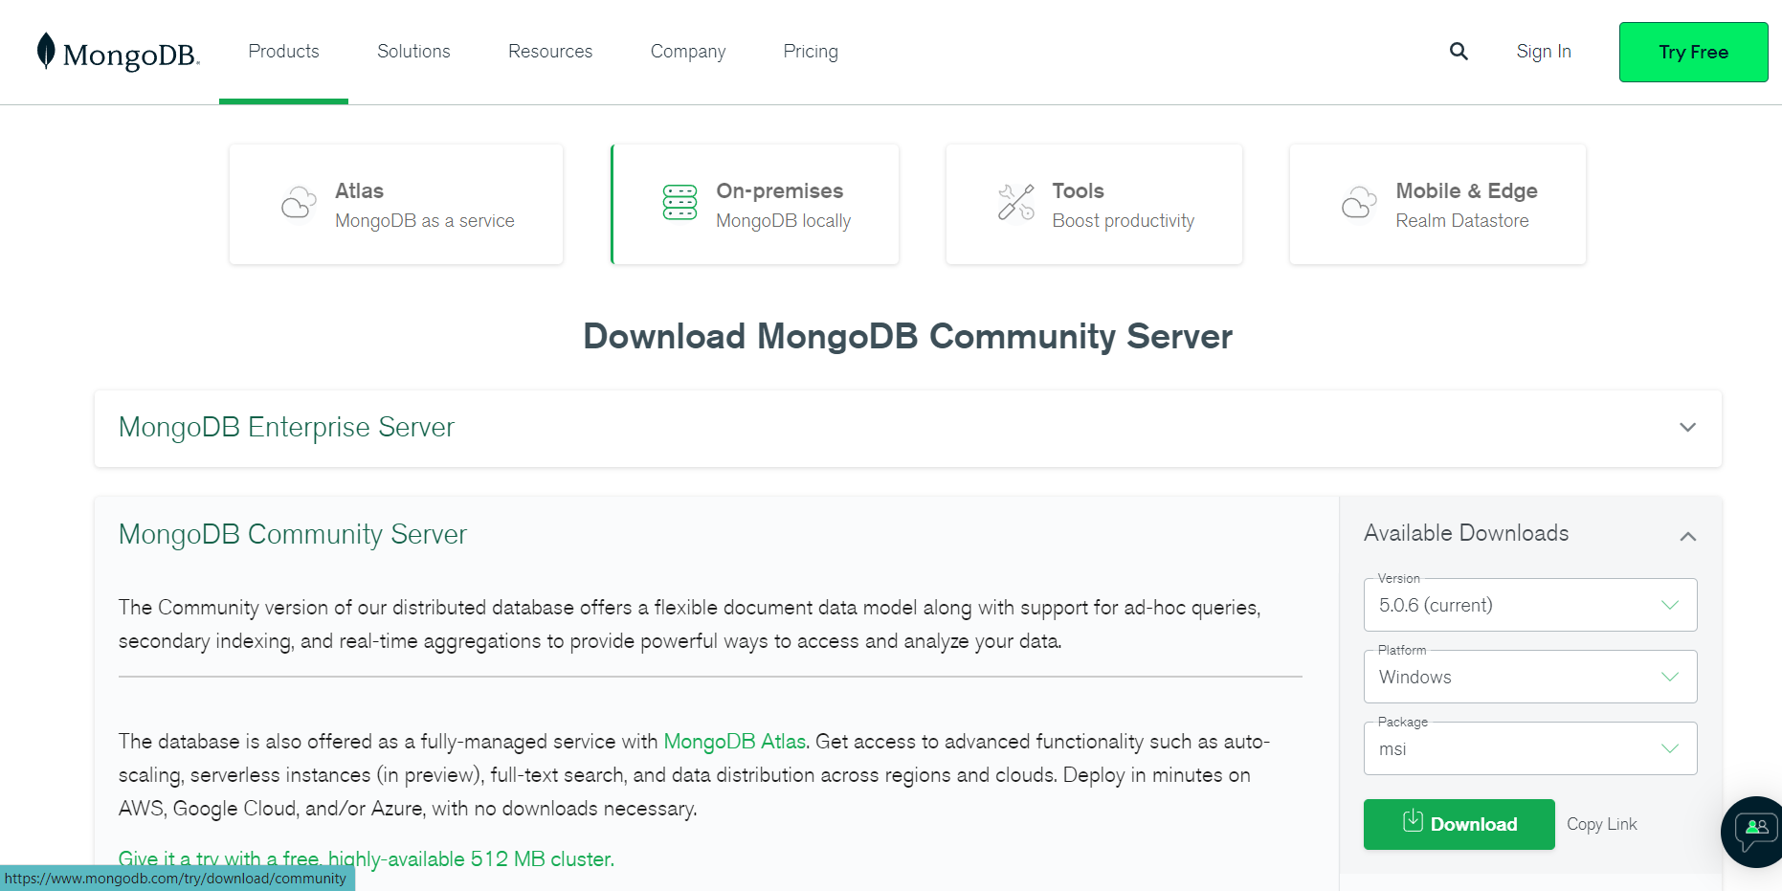
Change accordingly based on need of your PC and only download package in msi

Slide 7
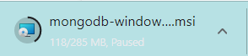
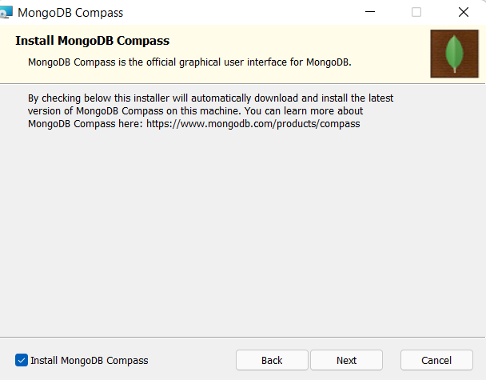
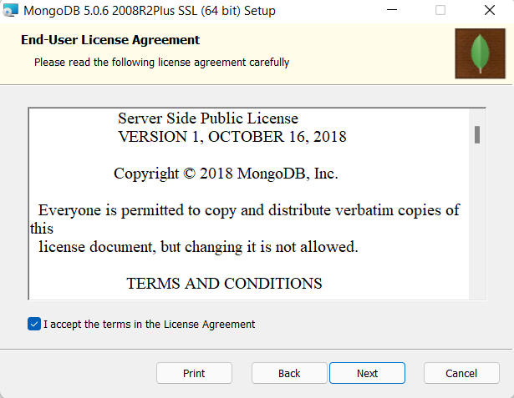
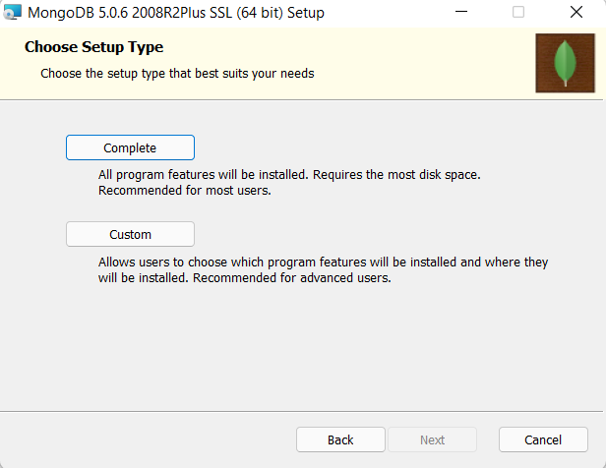
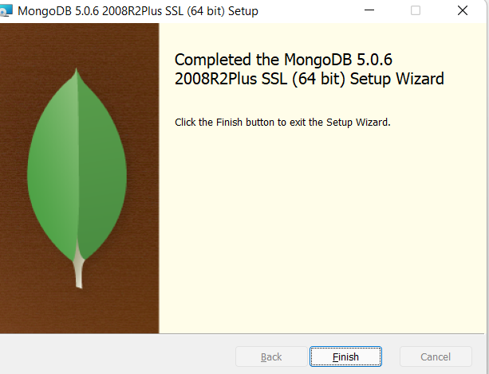
Click>> NEXT to complete download
Once completed the above kind of window will be popping up
Click>>Finish

Slide 8
After completing Server Download Click>> Tools for next page and other downloads

Slide 9
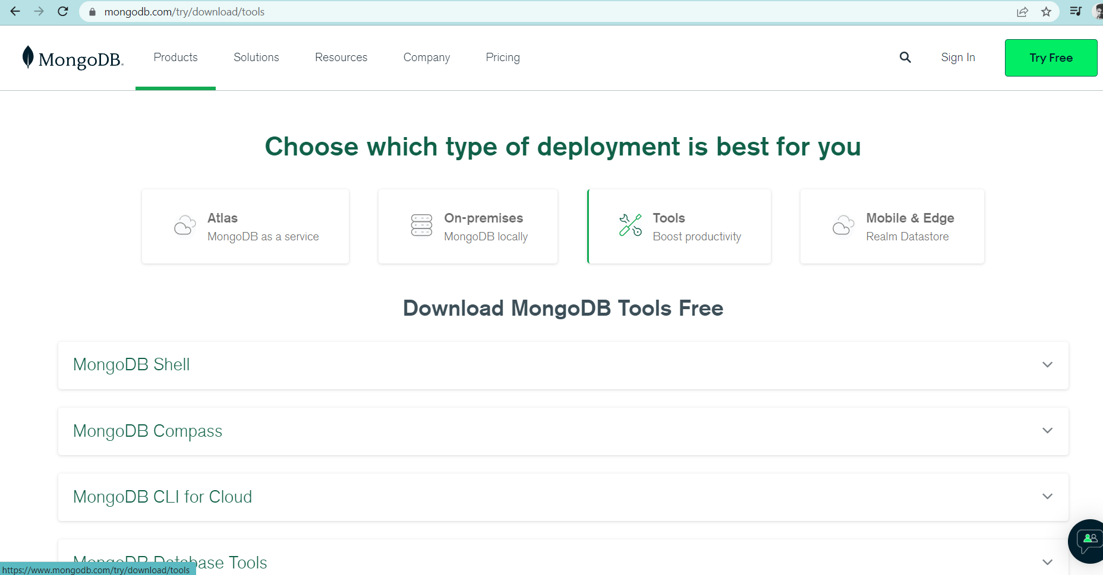
Click>> MongoDB Shell to download

Slide 10
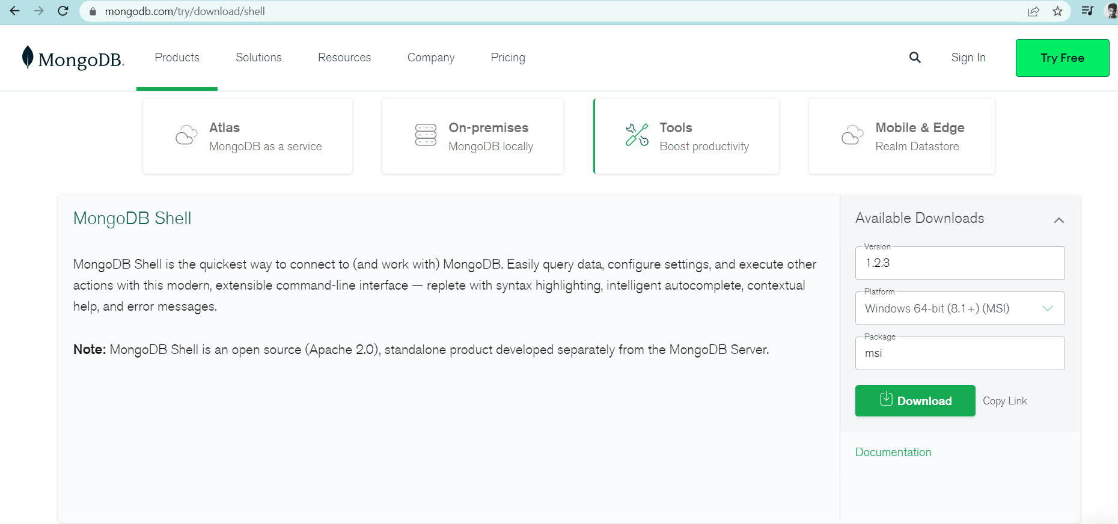
Only msi type of file need to be downloaded and change platform according to PC’s

Slide 11
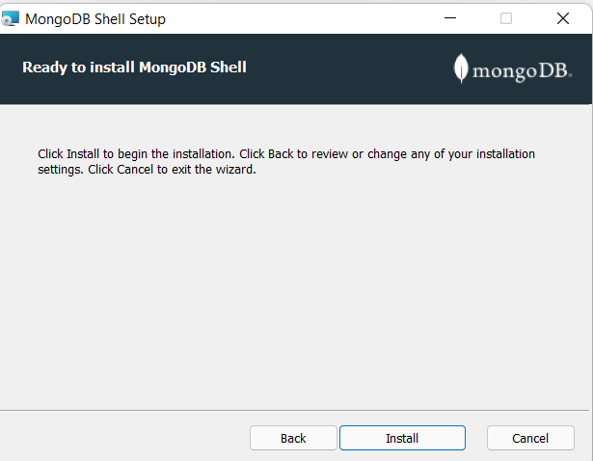
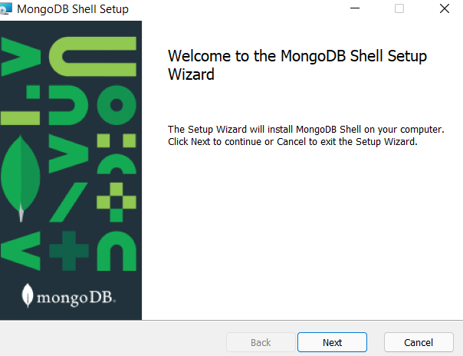
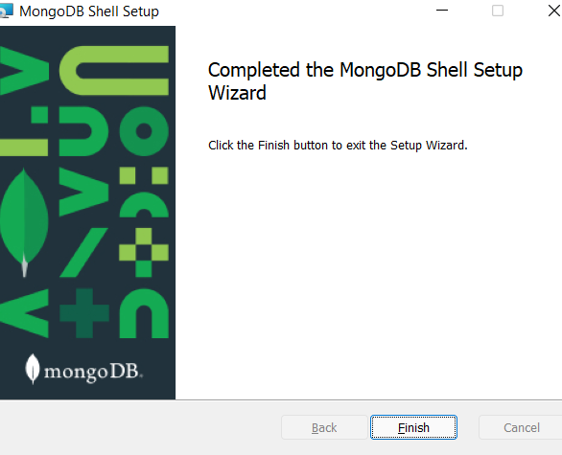
Click>> Next >>Next >> Install

Slide 12
After installing Shell Click>> MongoDB Compass

Slide 13
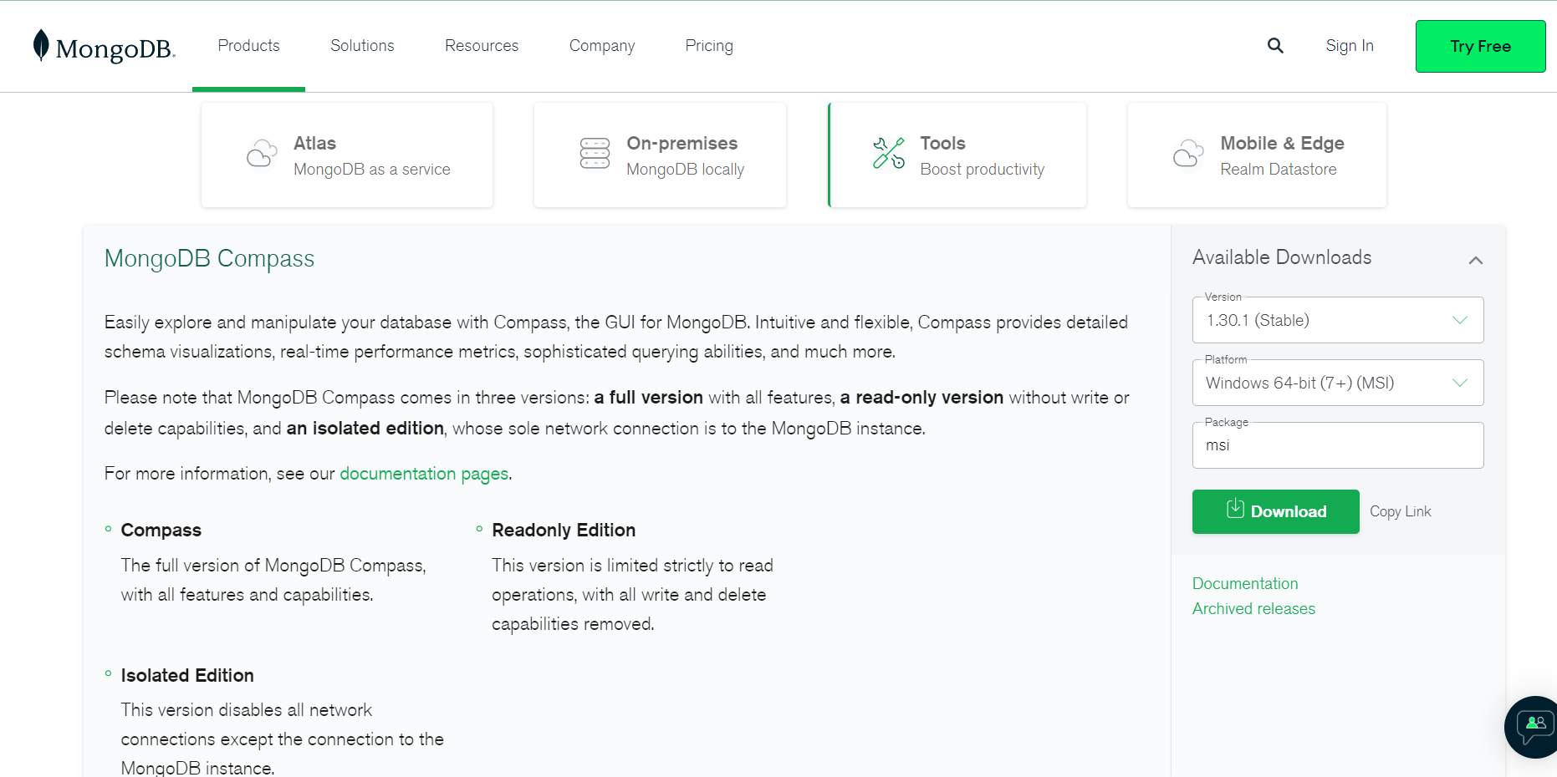
Only msi type of file need to be downloaded and change platform according to PC’s

Slide 14
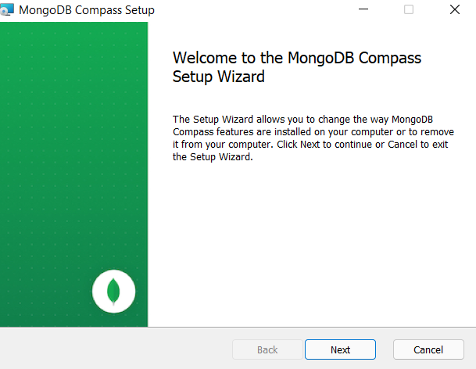
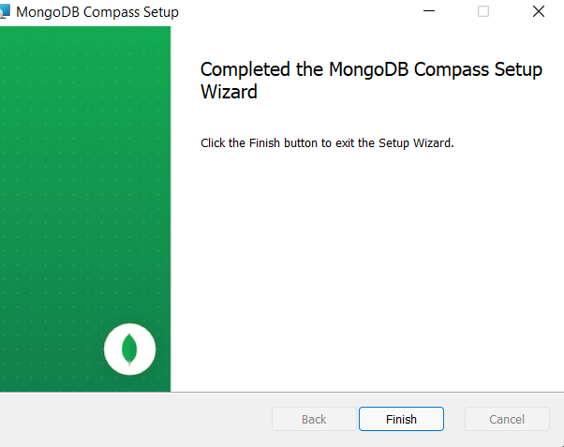
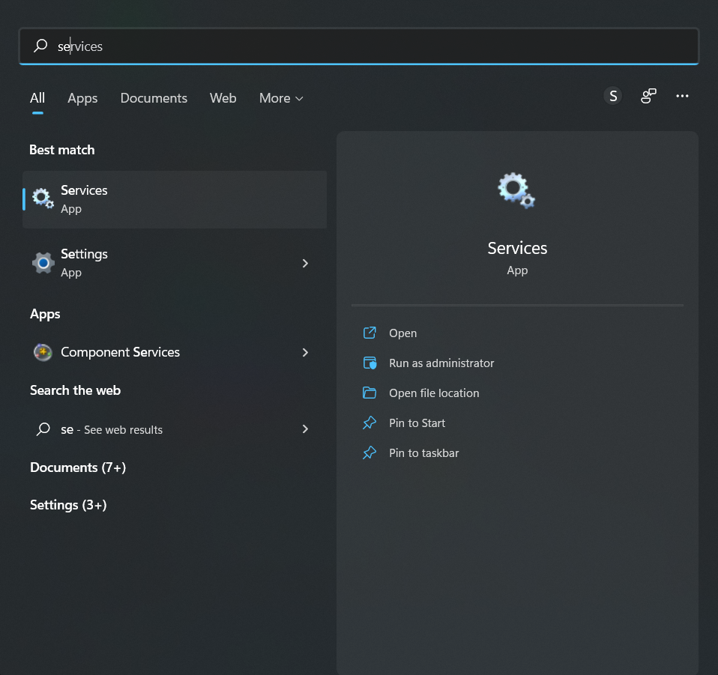
After completing download click >> Open And Click >> Next >> Complete >> Install >> Finish
After installing all three files >> Search in Search bar >> Services

Slide 15
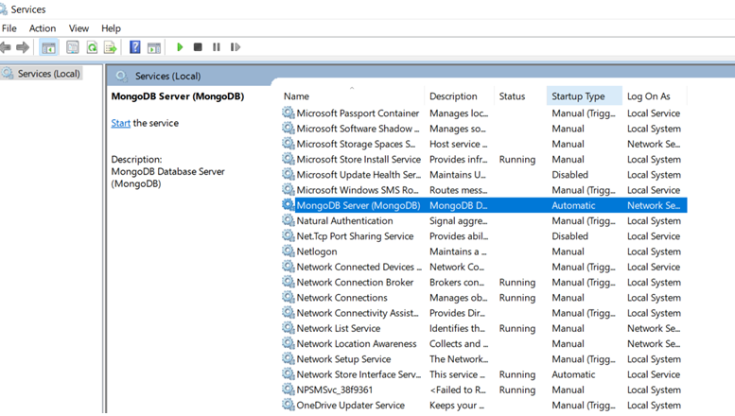
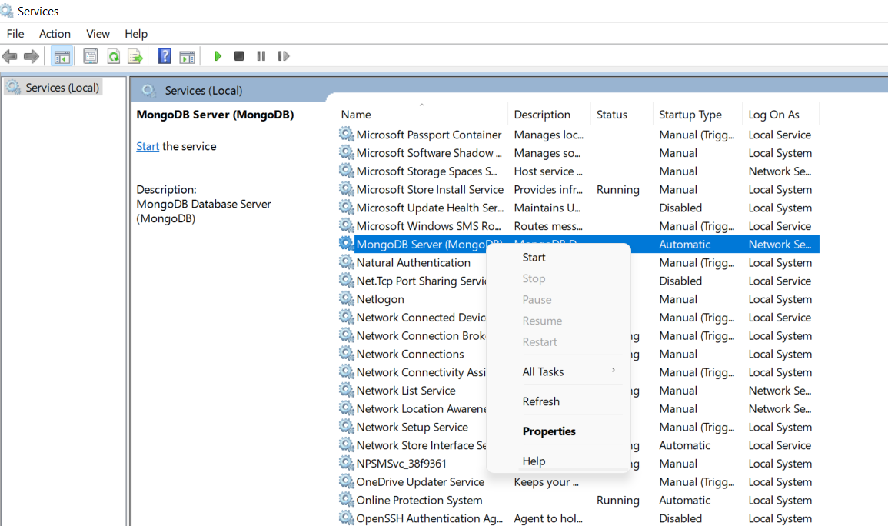
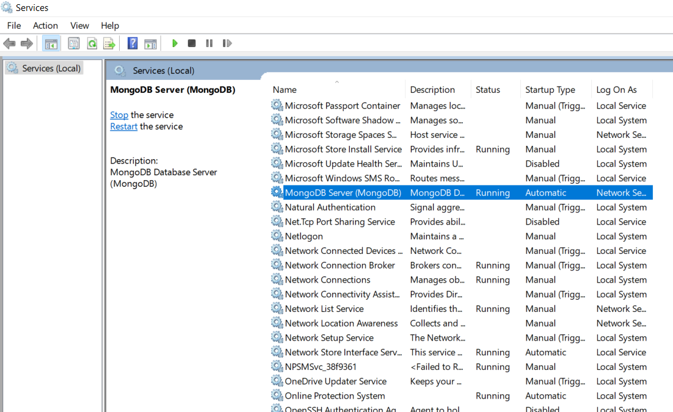
After installing MongoDB Server check here whether the server is running or not
If it is not running keep the curser on MongoDB Server and Click >>Right >> Start
Running status will be shown

Slide 16
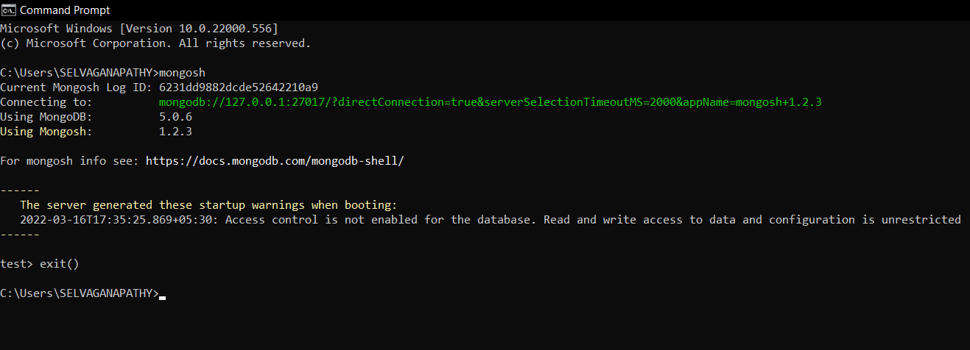
TO CHECK WHETHER MONGODB AND MONGODB SHELL INSTALLED
TYPE : mongosh

Slide 17
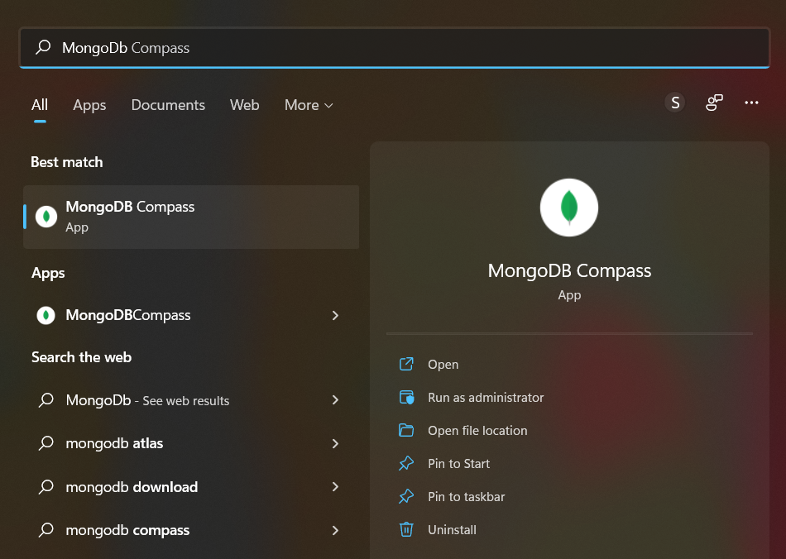
>> Open

Slide 18
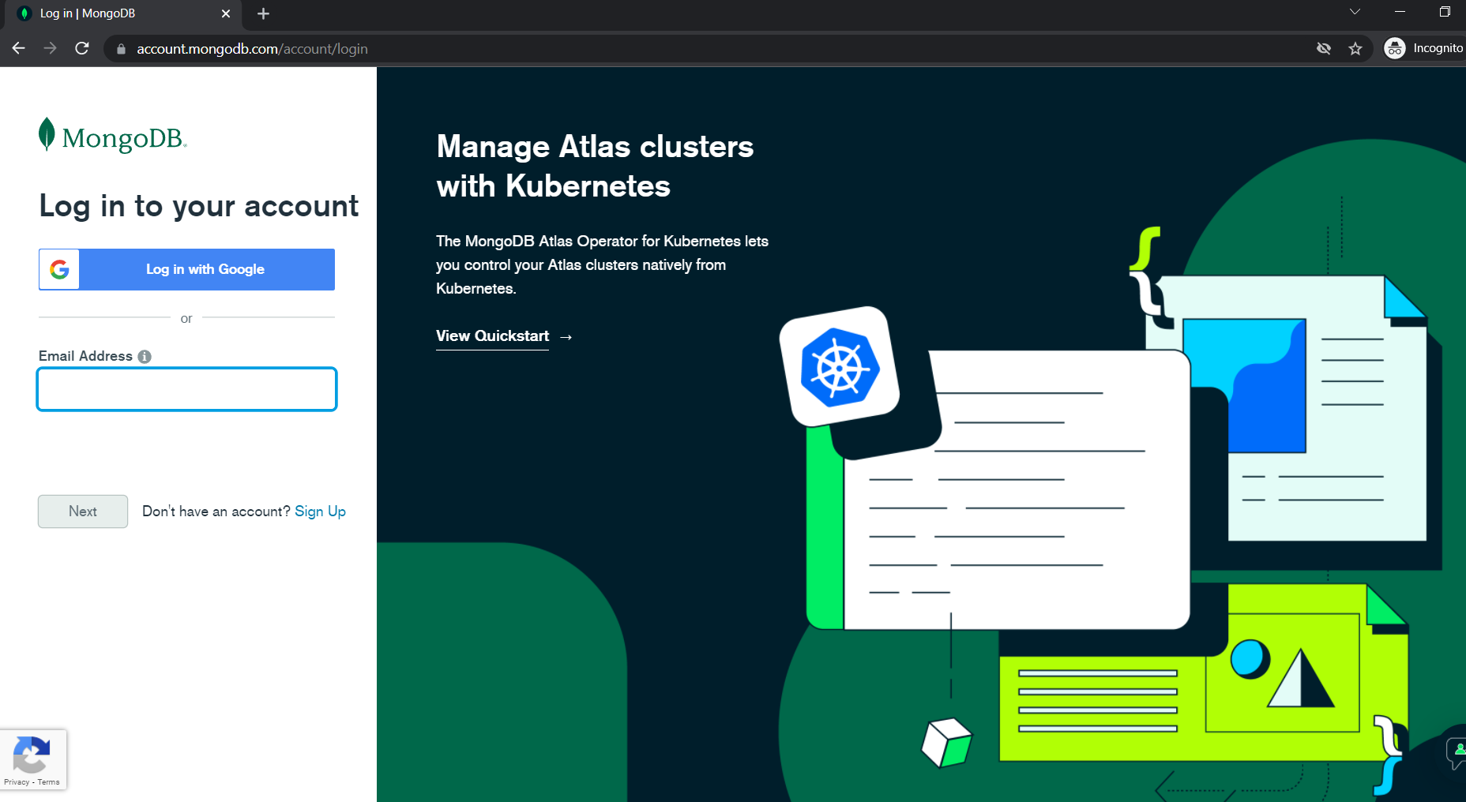
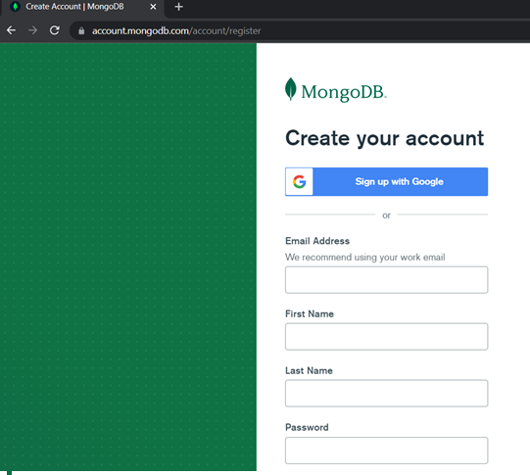
Sign in using Google Account

Slide 19
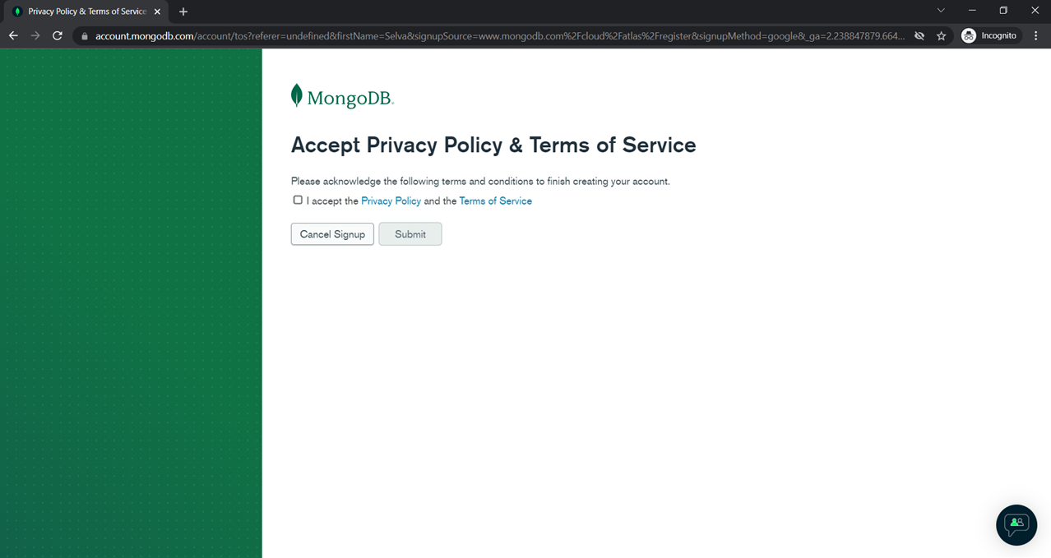
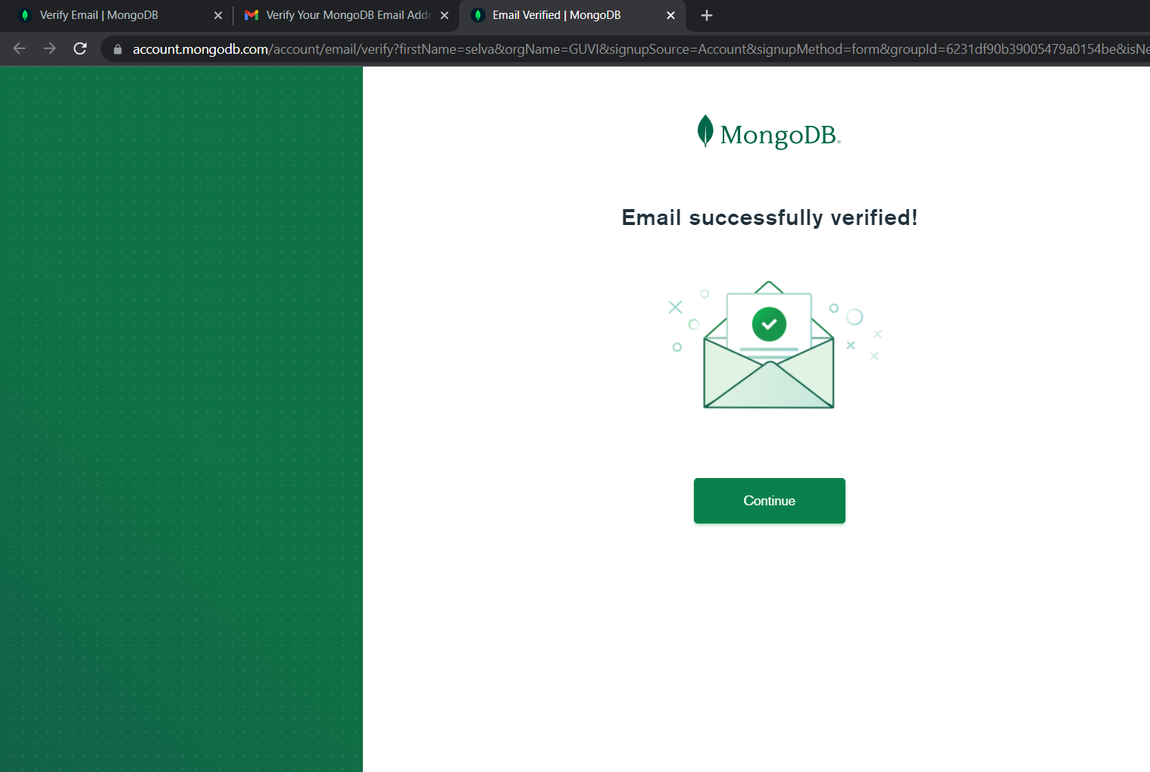
Accept terms and Click >> Submit
Verify E-Mail

Slide 20
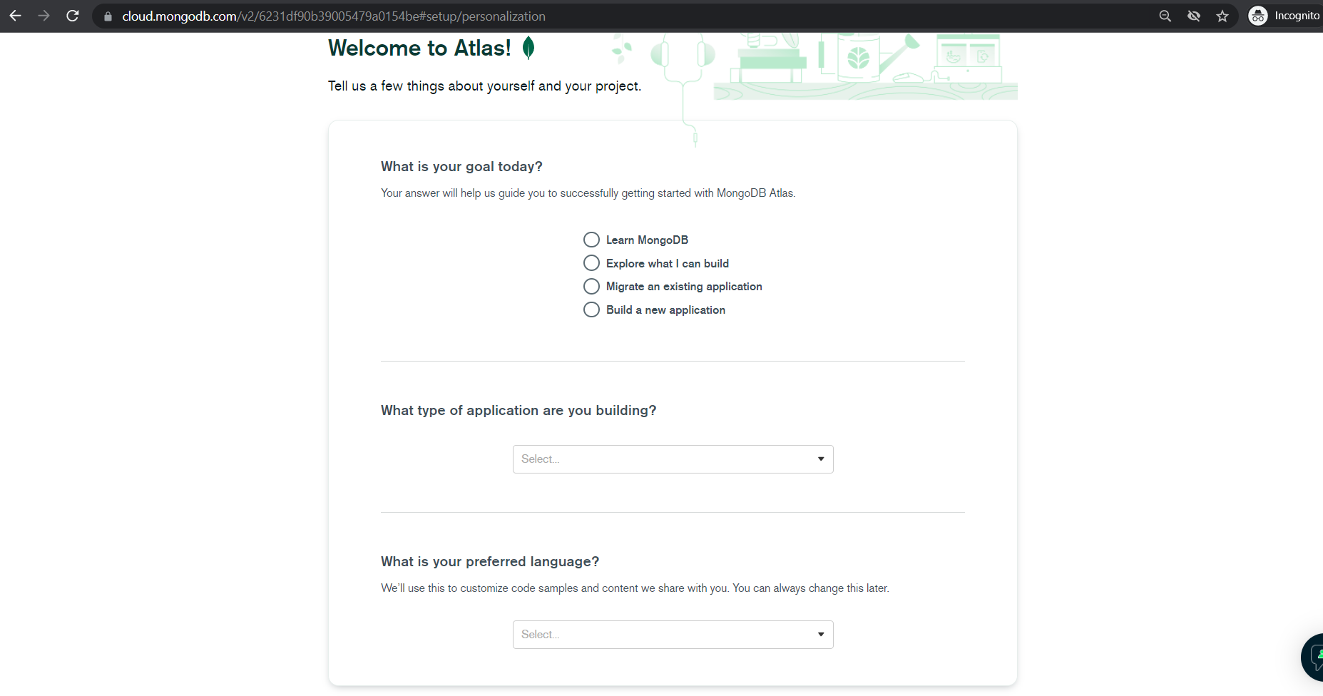
Fill accordingly and procced
Select: PYTHON AND CLICK >> FINISH

Slide 21
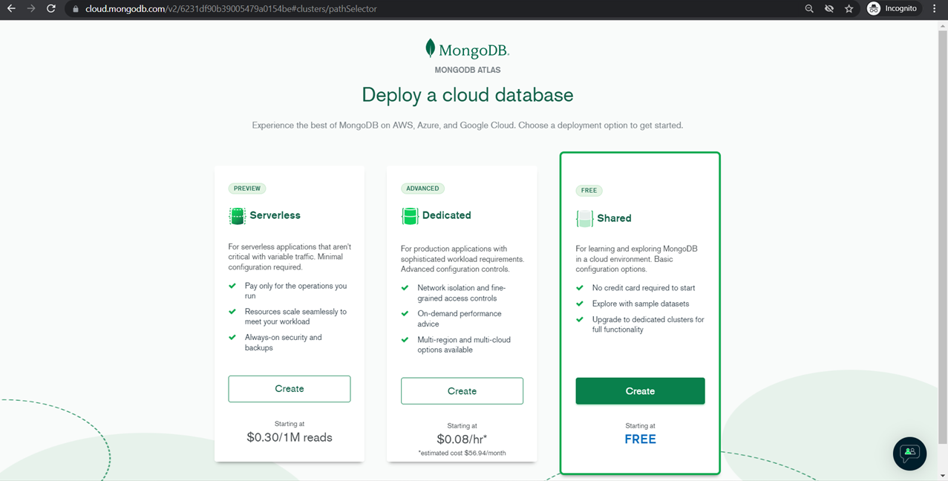
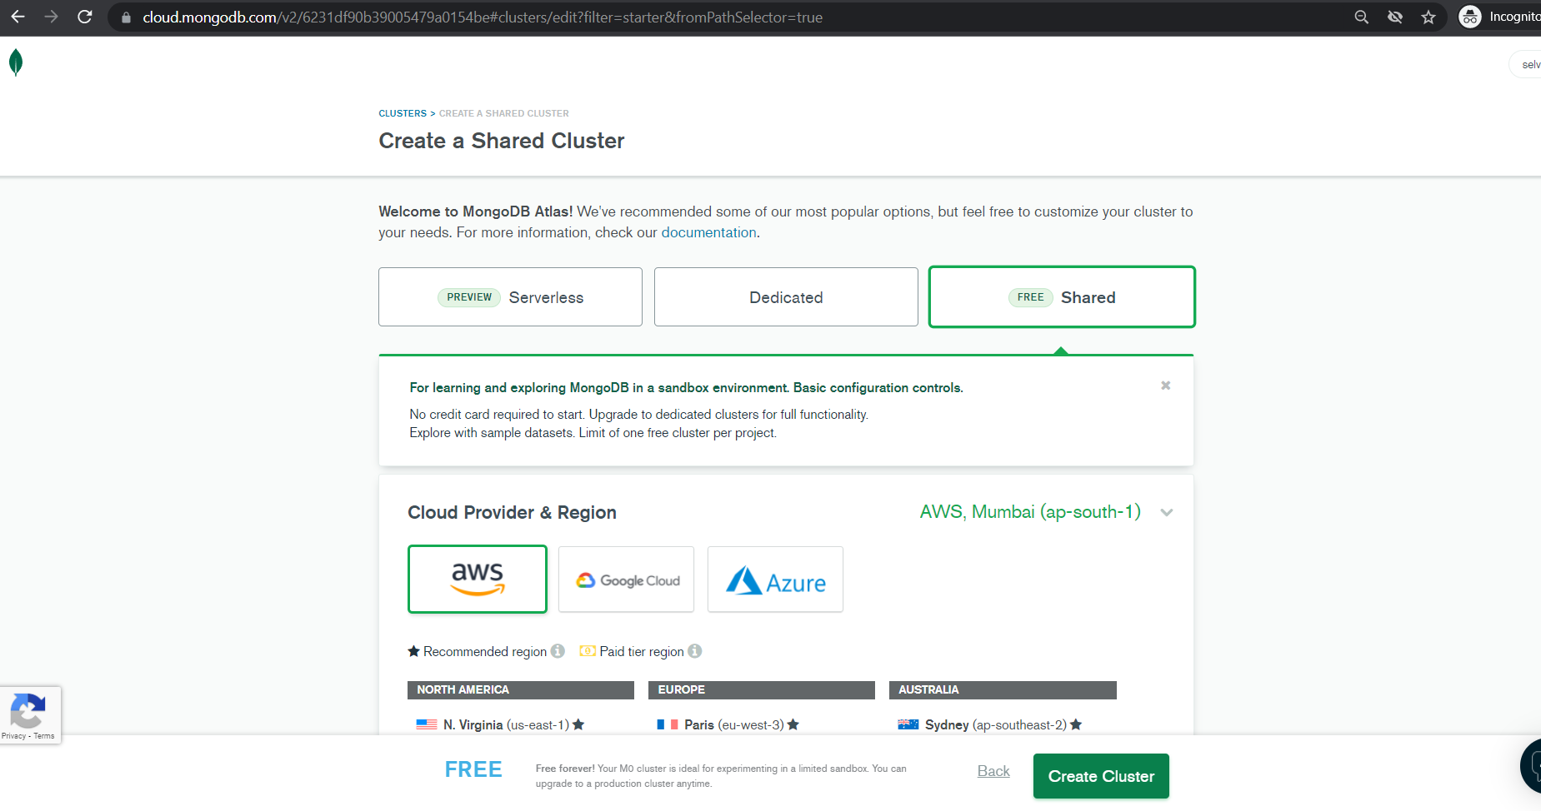
Select FREE and create
Don’t the disturb default setting and Click >> Create Cluster
Default Options:
AWS
MUMBAI

Slide 22
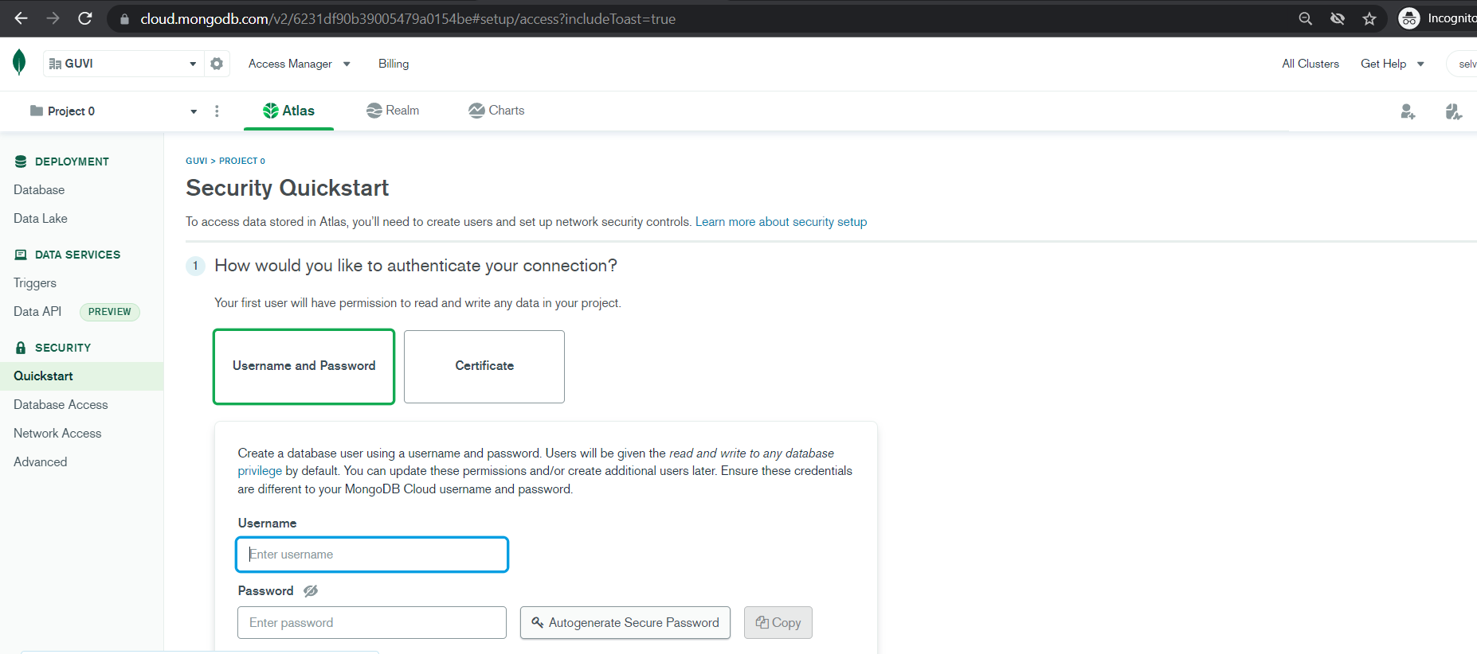
Create User_name and Password and Click >> Create User
And Scroll Down

Slide 23
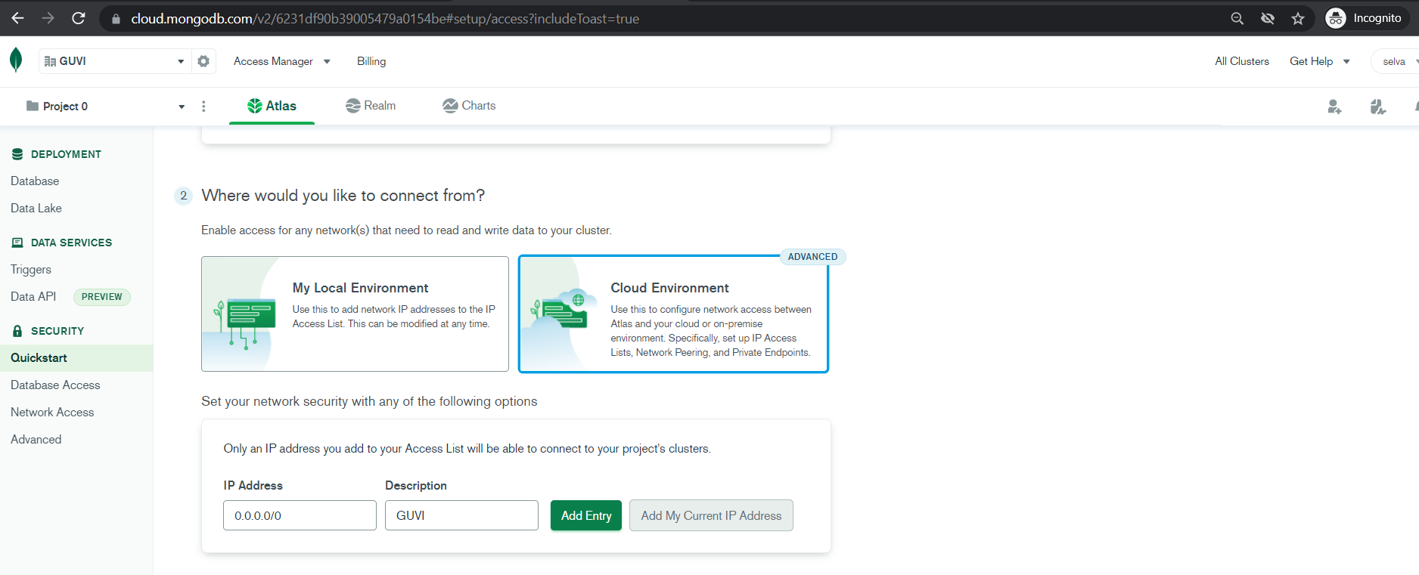
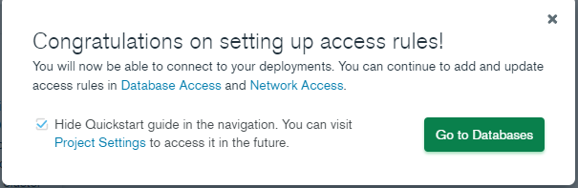
Add IP address as above or Add Current IP address by clicking >> Add My IP Address
And click Finish

Slide 24
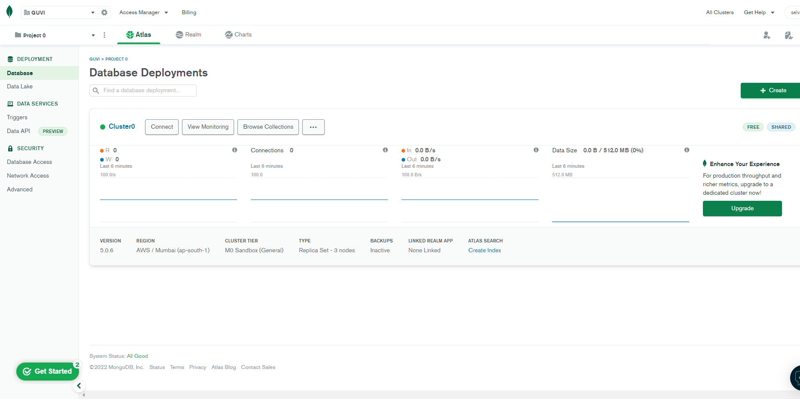
After Click >> Go to Database

Slide 25
CLICK >> CONNECT

Slide 26
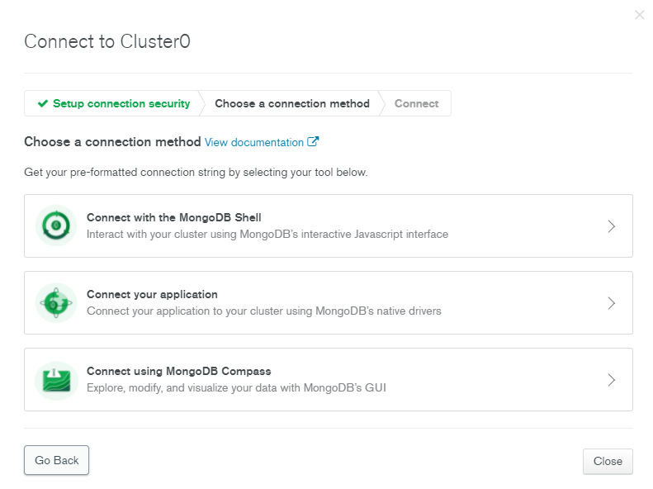
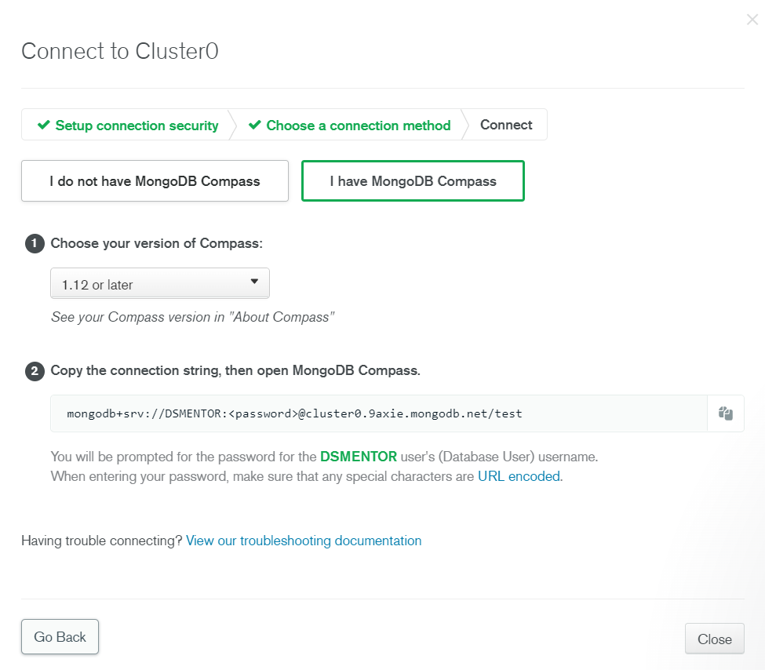
Click >> Connect your Compass
Choose as mentioned and copy that link

Slide 27
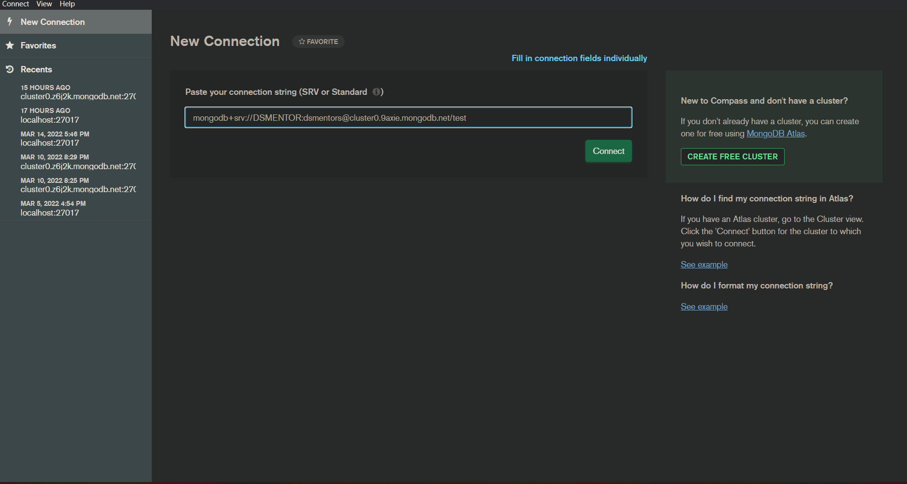
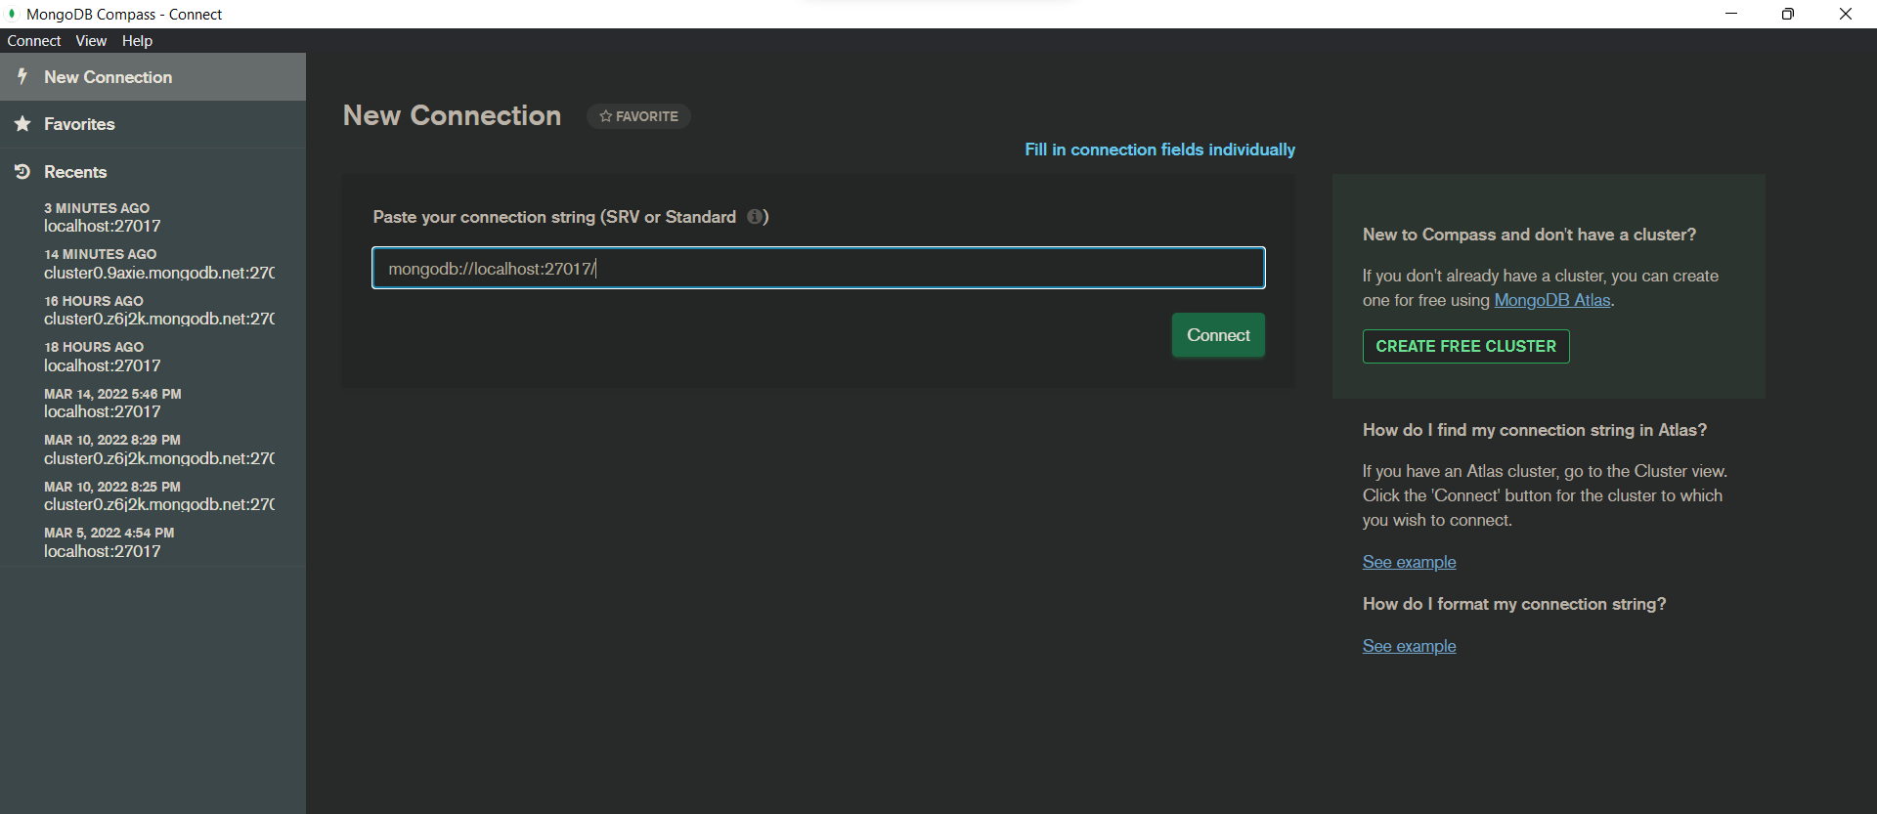
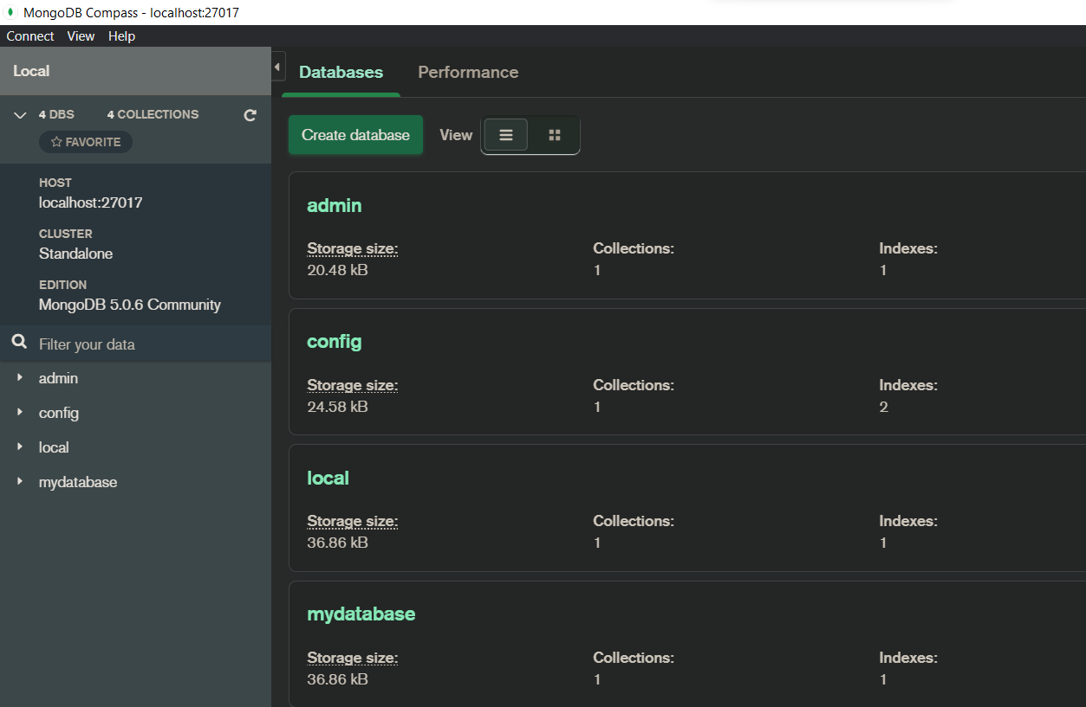
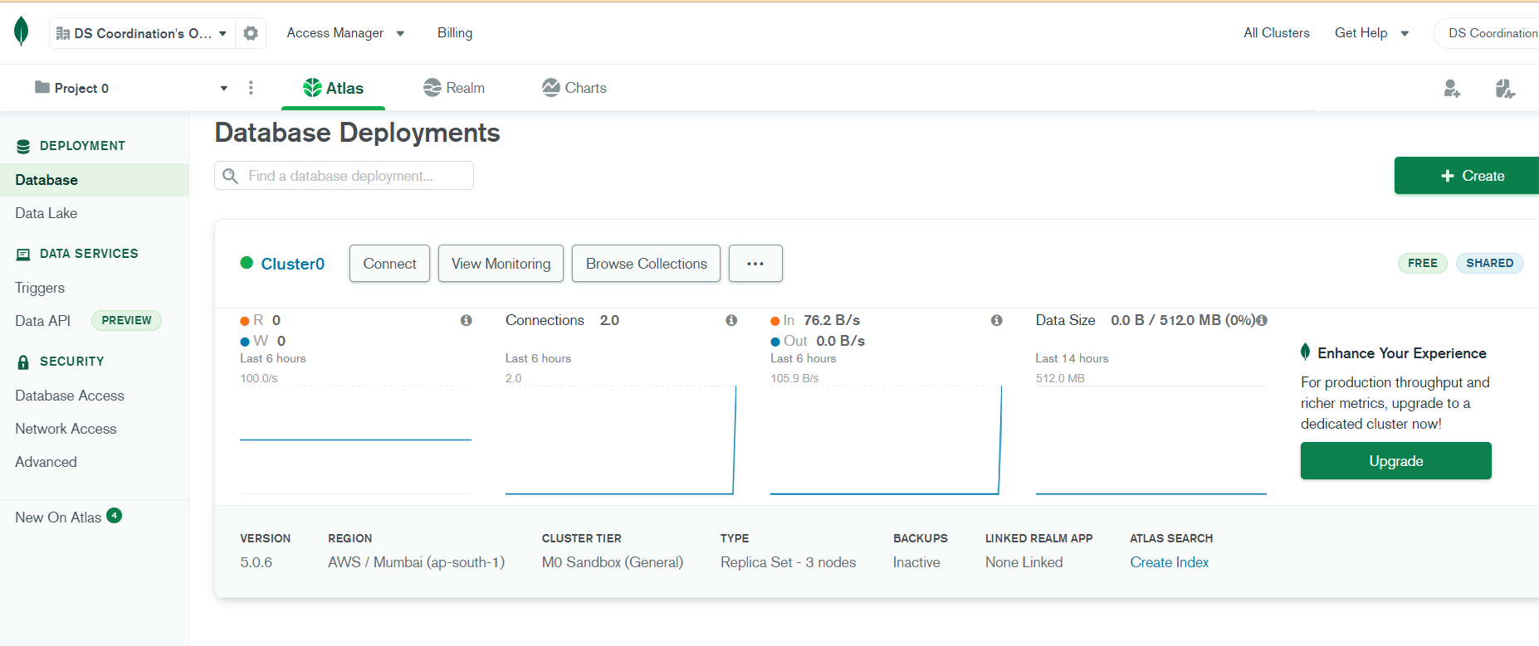
Copy and paste the link inside the application as New Connection
Link to get connect with local >> mongodb://localhost:27017/

Slide 28
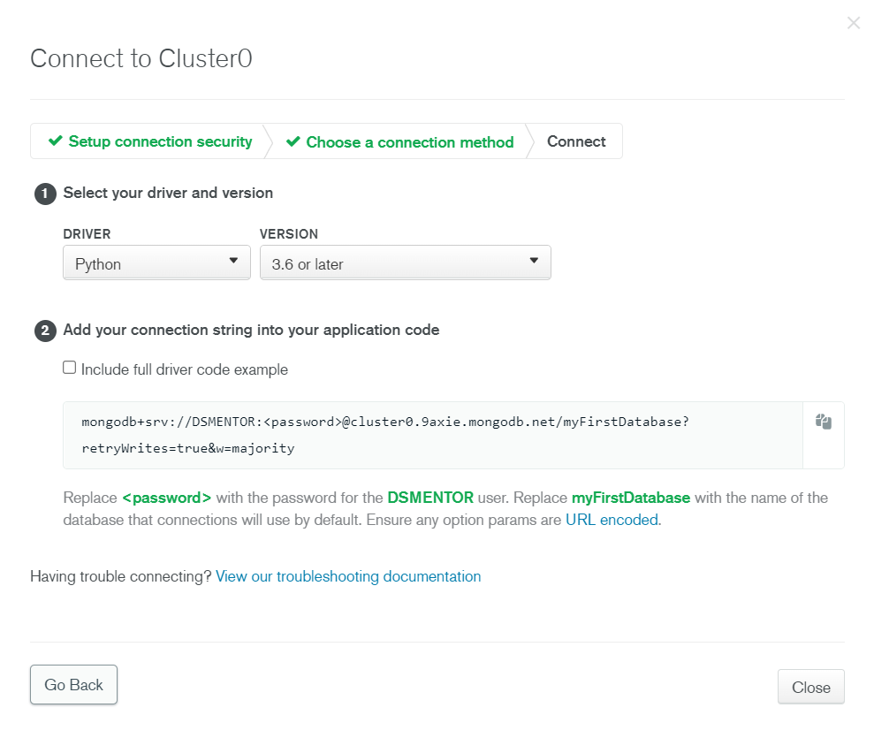
Click >> Connect your Application
Choose as mentioned and copy that link

Slide 29
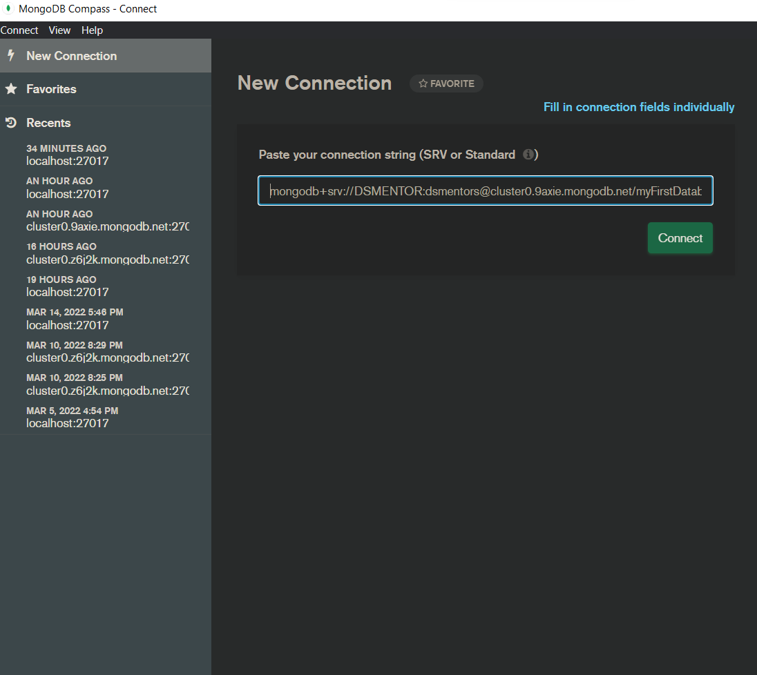
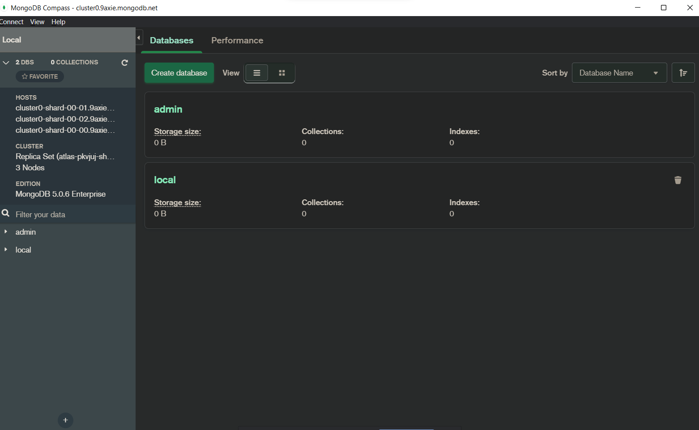
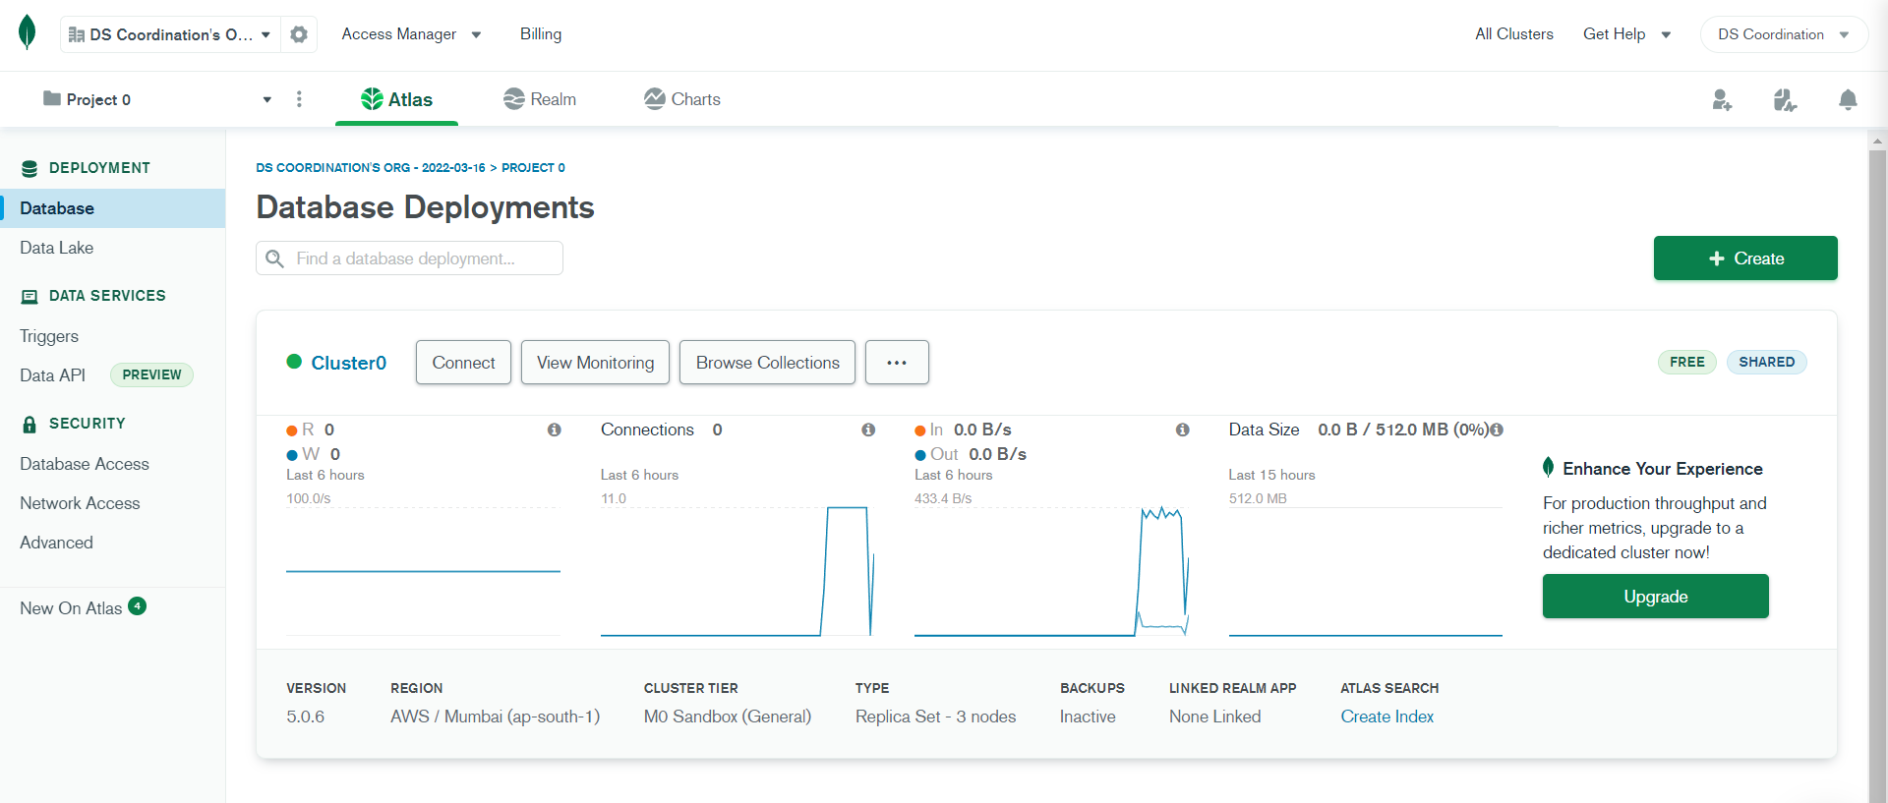
Click
Connected to online cluster

Slide 30
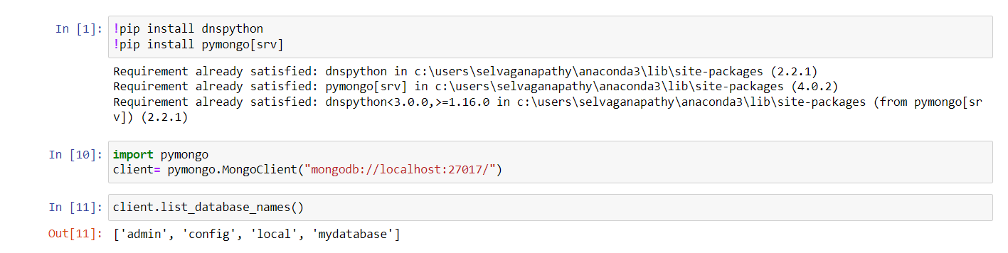
Connect your MongoDB application in LOCAL and CLOUD following steps are below:
To get connect with Local Host >> Link >> mongodb://localhost:27017/
Write a code in IDE to install pymongo

Slide 31
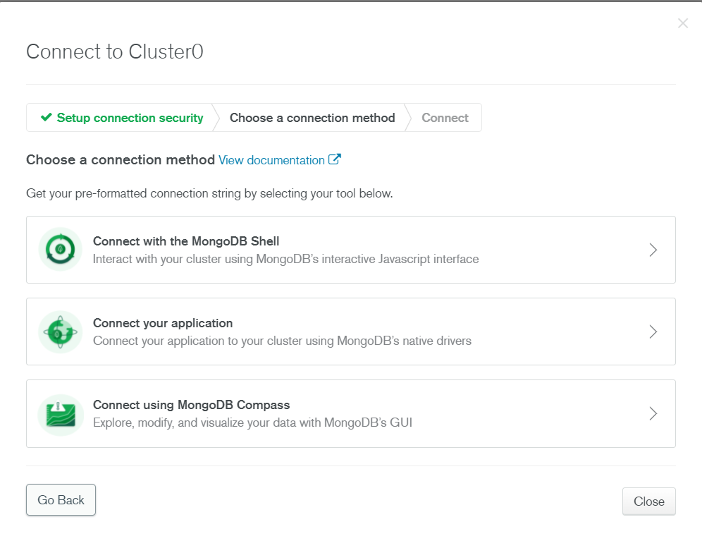
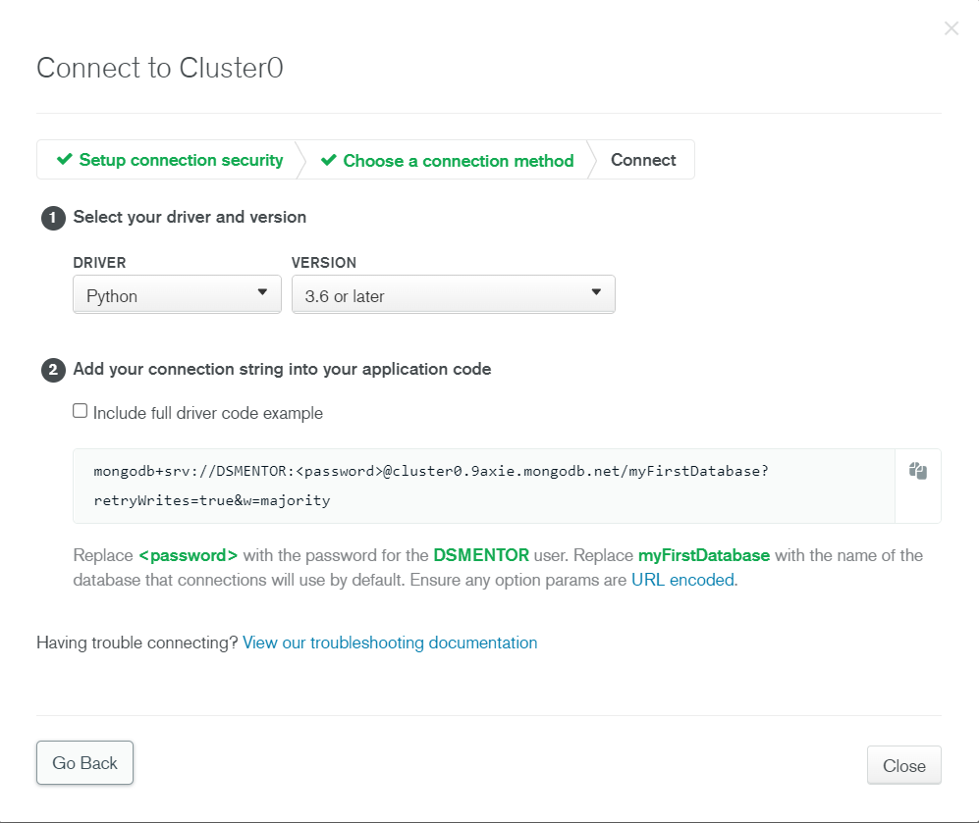
GET THE LINK FROM MONGODB ATLAS
Click Your Application
Copy link and paste in application

Slide 32
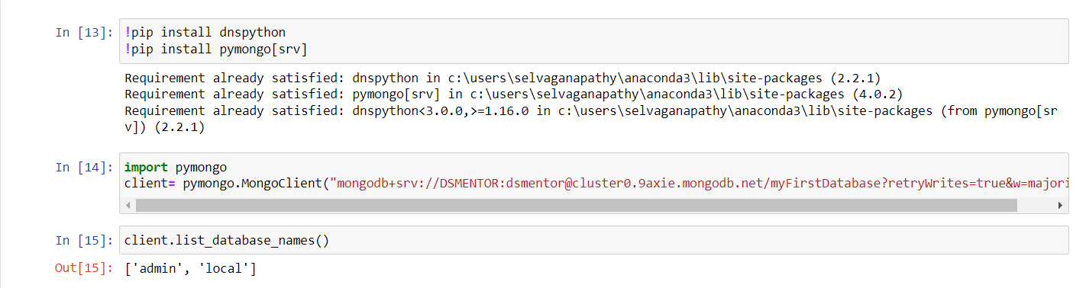
Paste the link in IDE and

Slide 33

To connect MongoDB shell to local :
My computer >> Windows(C;) >> Program Files >> MongoDB >> Server >> 5.0 >> Bin

Slide 34


Slide 35


Click to connect mongodb shell
Kindly check the shell version
Kindly copy the link and paste in the Command Prompt

Slide 36

Link copied from Mongodb Atlas
Type >> show dbs

